Slide 1
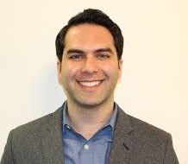
Critical Social/Personality & Environmental Psychology
Brown Bag Lecture Series Fall 2018
Bijan Kimiagar, Ph.D. Associate Executive Director For Research
Citizen’s Committee for Children
Better Know a District: Findings from an Assessment of Community Assets and the Needs on the Shore of Staten Island
Wednesday, October 3, 2018 11:45am, Room 6304.01

