Slide 1
EDSE 2700E
Middle and Secondary School Mathematics: Teaching Developmentally
Dr. Shana Elizabeth Henry
23rd of April 2015

Slide 2
EDSE 2700E
Middle and Secondary School Mathematics: Teaching Developmentally
Dr. Shana Elizabeth Henry
23rd of April 2015
 | Activity | Minutes | Time
1 | Reflection of Last Class | 5 min | 7:30 – 7:35
2 | Articles, Discussion Questions | 25 min | 7:35 – 8:00
3 | Warm UP: Dice | 30 min | 8:00 – 8:30
4 | Stick or Switch | 30 min | 8:30 – 9:00
5 | Diverse Games | 10 min | 9:00 – 9:10
6 | Review Info for next week | 10 min | 9:10 – 9:20

Slide 3
Last Week’s Topic: Data Analysis Apr. 16th, 2015

Slide 4
Week 10: Exploring Concepts of Probability

Slide 5
R&R
Van de Walle, John, Karp, Karen; & Bay-Williams, Jennifer. (2012). Chapter 22.
481

Slide 6
How will you teach/explain the different usage of the word ‘or’?
p. 465
What are common misconceptions in probability?

Slide 7
Week 10: Exploring Concepts
of Probabilities

Slide 8
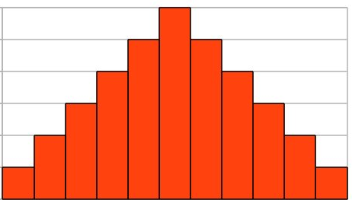
Warm Up

Slide 9
Monty’s Hall Problem!
What is behind the door? ☺

Slide 10
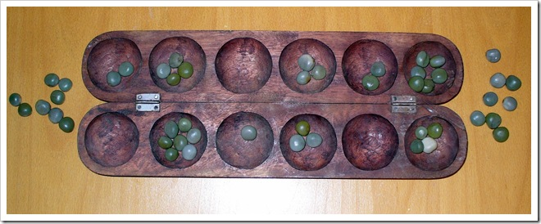
‘diverse’ games

Slide 12
Hybrid Course
Timeframe: 30 minutes per task
Task: Create online a portfolio of mathematical tasks that use manipulatives to engage students in their mathematical development.
Deadline: Post the link to your online portfolio by the beginning of class, May 15th, 2015.
Gallery Walk: May 15th, 2015

Slide 13
Minimum Requirements
Image of manipulative
Mathematical task
Appropriate grade range
Topic(s) that the task develops
Solution
Cite your source(s)

Slide 14
Review Info for next week

Slide 15
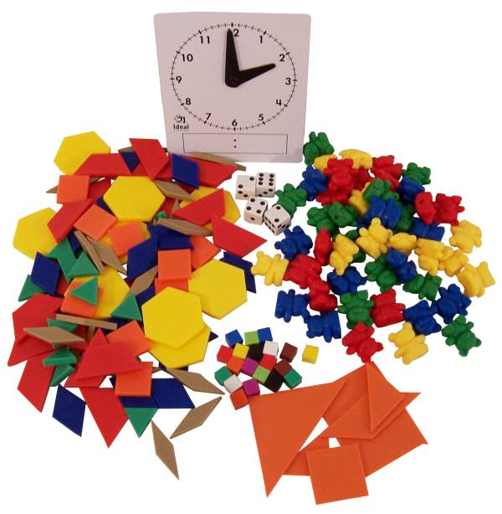
Review Info for next week

