Slide 1
EDSE 2700E
Middle and Secondary School Mathematics: Teaching Developmentally
Dr. Shana Elizabeth Henry
12th of March 2015

Slide 2
EDSE 2700E
Middle and Secondary School Mathematics: Teaching Developmentally
Dr. Shana Elizabeth Henry
12th of March 2015
 | Activity | Minutes | Time
1 | Reflection of Last Class | 10 min | 7:30 – 7:35
2 | Articles, Discussion Questions | 25 min | 7:35 – 8:00
3 | Activity w/ Summary | 60 min | 8:00 – 9:00
4 | Review Info for next week | 20 min | 9:00 – 9:20

Slide 3
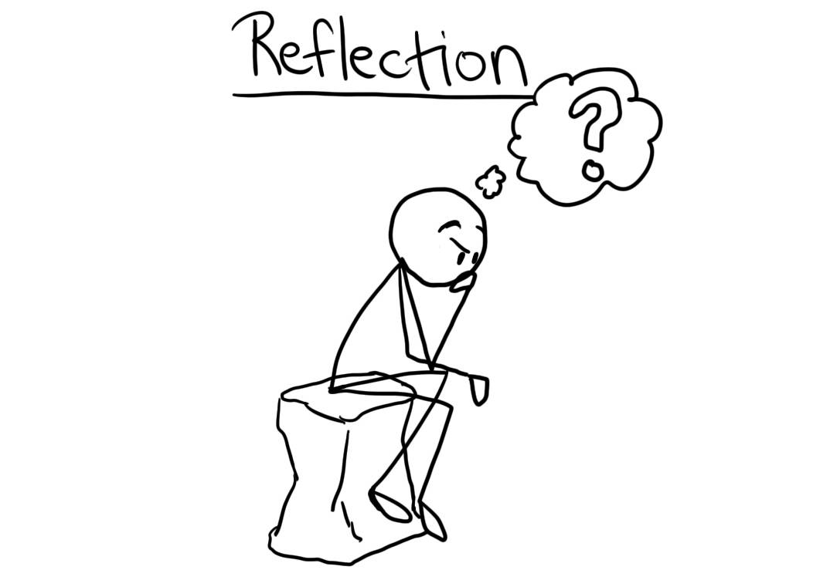
Weekly Topic: Developing Measurement Concepts Mar. 5th, 2015

Slide 4
Week 6: Developing Concepts of Exponents, Integers, and Real Numbers

Slide 5
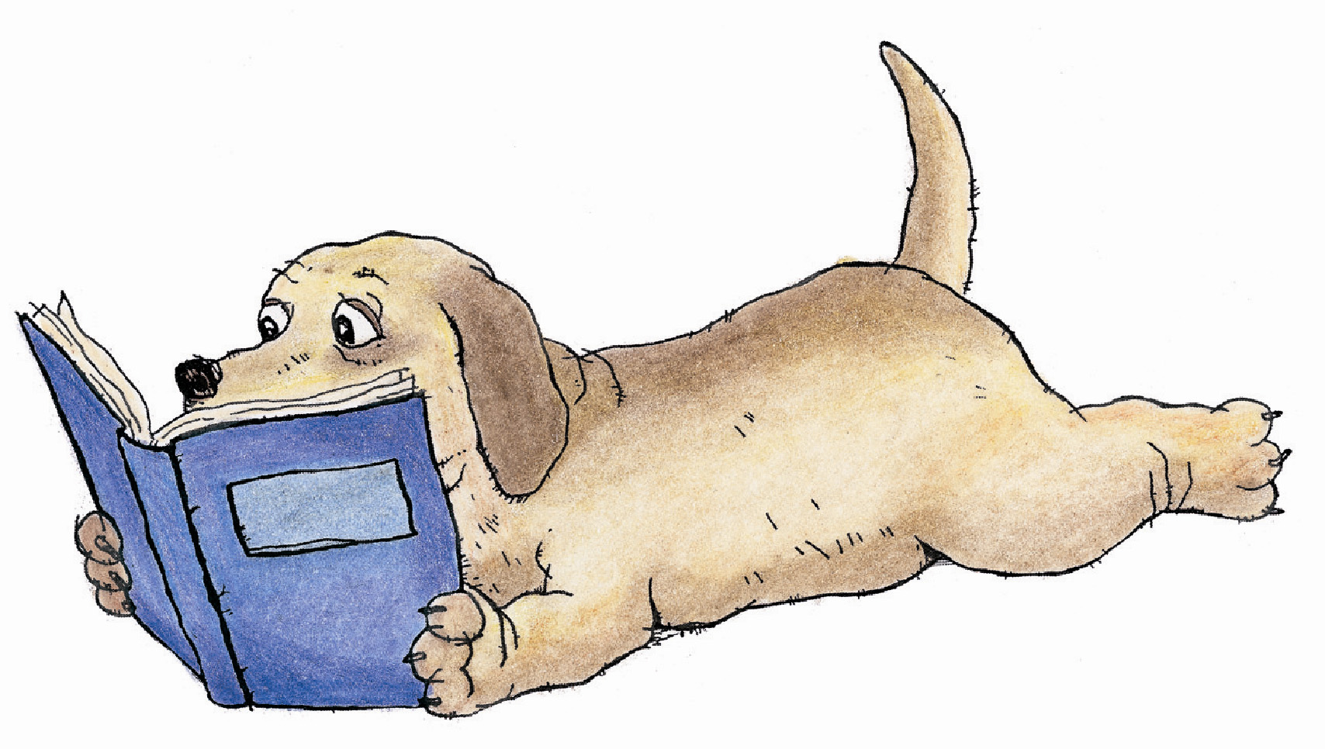
R&R
Van de Walle, John, Karp, Karen; & Bay-Williams, Jennifer. ( 2012). Chapter 23.
“It is important to connect to their prior knowledge
and explicitly build meaning for the new symbols”. p.
p. 481

Slide 6
How would you explain the difference between a rational and an irrational number to a middle school student? p. 489
Figure 23.13
An illustration of the real numbers.
Would you change it? If so, how?
p.486

Slide 7
Rational, Irrational, and real numbers video.

Slide 8
Week 6: Developing Concepts of
Exponents, Integers, and Real Numbers

Slide 9
Warm Up Activity 23.10 p. 486
Repeater or Terminator?

Slide 10
MY Personal Time Line

Slide 11
Class project

Slide 12
Planning for Final Project
Bring five copies of a written description of your chosen concept and the task or activity you intend to use in order to receive feedback from the instructor and from your peers.

Slide 14
Hybrid Course
Timeframe: 30 minutes per task
Task: Create online a portfolio of mathematical tasks that use manipulatives to engage students in their mathematical development.
Deadline: Post the link to your online portfolio by the beginning of class, May 15th, 2015.
Gallery Walk: May 15th, 2015

Slide 15
Minimum Requirements
Image of manipulative
Mathematical task
Appropriate grade range
Topic(s) that the task develops
Solution
Cite your source(s)

Slide 16
Review Info for next week

Slide 17
Review Info for next week

