Slide 1
EDSE 2700E
Middle and Secondary School Mathematics: Teaching Developmentally
Dr. Shana Elizabeth Henry
26th of February 2015

Slide 2
EDSE 2700E
Middle and Secondary School Mathematics: Teaching Developmentally
Dr. Shana Elizabeth Henry
26th of February 2015
 | Activity | Minutes | Time
1 | Reflection of Last Class | 5 min | 7:30 – 7:35
2 | Articles, Discussion Questions | 25 min | 7:35 – 8:00
3 | Activity w/ Summary | 60 min | 8:00 – 9:00
4 | Review Info for next week | 20 min | 9:00 – 9:20

Slide 3
Weekly Topic: Proportional Reasoning Feb. 19th, 2015

Slide 4
Week 4: Algebraic Thinking:
Generalizations,
Patterns, & Functions

Slide 5
R&R
Van de Walle, John, Karp, Karen; & Bay-Williams, Jennifer. ( 2012).
Elementary and Middle School Mathematics: Teaching Developmentally
Chapter 14.

Slide 6
Soares, Blanton, and Kaput (2006) describe how to “algebraify” the elementary curriculum. What do you think? p. 284
Five different representations of a function. For any given function, students should see that all these representations are connected and illustrate the same relationship. What do you think? p. 284

Slide 7
Week 4: Algebraic Thinking:
Generalizations, Patterns, & Functions

Slide 8
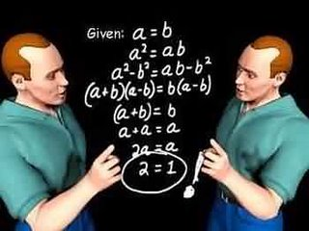
Warm Up

Slide 9
Warm Up
What model best represents the fare increases of the NYC subway?

Slide 10
Class project
mobiles

Slide 12
Hybrid Course
Timeframe: 30 minutes per task
Task: Create online a portfolio of mathematical tasks that use manipulatives to engage students in their mathematical development.
Deadline: Post the link to your online portfolio by the beginning of class, May 15th, 2015.
Gallery Walk: May 15th, 2015

Slide 13
Minimum Requirements
Image of manipulative
Mathematical task
Appropriate grade range
Topic(s) that the task develops
Solution
Cite your source(s)

Slide 14
Review Info for next week

Slide 15
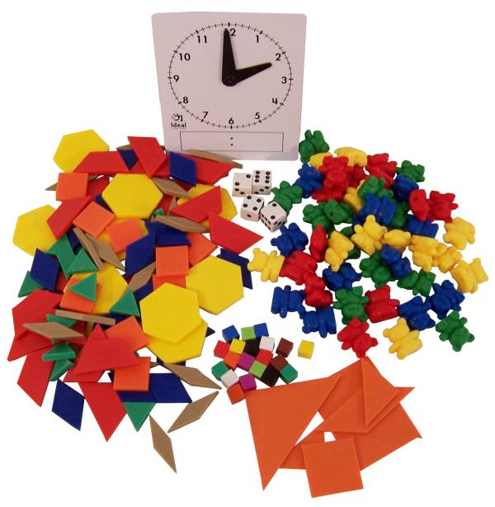
Review Info for next week

