Slide 1
Active Learning
in the math classroom

Slide 2
Guided Discovery

Slide 3
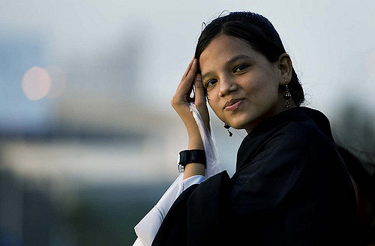
This is Marissa.
She wants to get her MA in teaching.
She needs 12 credits.
She got accepted to both Hunter College and SUNY Purchase.
(You’re paying for her degree!)
Image description: young woman brushing hair from her eyes.

Slide 4
Hunter College
SUNY Purchase
How can we tell...
Needs 12 credits | $560 per credit | One-time technology fee = $150
Needs 12 credits | $630 per credit | No technology fee.
Which one is cheaper? What’s the
difference in cost?

Slide 5
Which of these equations show us how much cheaper Hunter is than SUNY? Why?
(560x12)+150=H (630x12)=S S-H=X
560+150(12)=H 630/12=S S-H=X
c. 560(12)+150=H 630(12)=S S-H=X d. 560(12)+150(12)=H 630(12)=S S-H=X
*More than one answer is possible!

Slide 6
Hunter College
How much is a 3-credit class at Hunter + the tech fee? What about a 4-credit class?
Needs 12 credits | $560 per credit | One time technology fee = $150

Slide 7
Hunter College
Marissa is taking Introduction to Teaching (3 credits) and a Teaching Lab (4 credits) her first year. How much will we need to raise?
Needs 12 credits | $560 per credit | One time technology fee = $150

Slide 8
SUNY Purchase
How much is a 3-credit class at SUNY Purchase?
How much is a 4-credit class at SUNY Purchase?
Needs 12 credits | $630 per credit | No technology fee

Slide 9
Complete the table below that gives the total cost a student pays at each college, including Hunter’s one time technology fee, for taking any number from 3 to 12 credits during a semester.
Verify your results by creating a table in your graphing calculator.
Number of credits (n) | Cost at Hunter (H) in $ | Cost at SUNY (S) in $
3 | $ | $
4 | $ | $
5 | $ | $
6 | $ | $
7 | $ | $

Slide 10
Take Aways:
When solving these equations, which did you have to do first: multiplication, addition, or subtraction?
Which of the following words tell you that you need to SUBTRACT: A. find the difference between X and Y B. find the sum of X and Y C. how much more is X than Y
D. how much will X receive and how much will Y receive
3. Which of these symbols tells you to MULTIPLY: A. 2(12) C. 12 x 2 B. 12 / 2 D. √12

Slide 11
Guided Discovery
(with unfamiliar content!)

Slide 12
Discuss with your partner. What is the relationship between SPELLING and SOUNDS in these words?
through
though
tough
trough

Slide 13
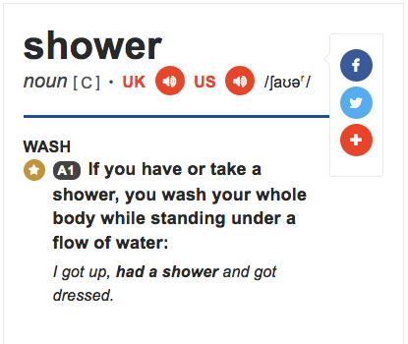
International Phonetic Alphabet (IPA)
/’ʃaʊər/ = shower
Image description: A screenshot of the word “shower” from the Cambridge Learner’s Dictionary which shows the IPA transcription of the word.

Slide 14
On a piece of scrap paper, copy this chart + write these words:
beak | music | cartoon | peak
2. teacher | kitchen | culture | picture
3. joke | giant | age | injure

Slide 15
What sound do these words have in common? Which part of the word makes them sound the same?
Ex: police, green, receipt, niece
beak, music, cartoon, peak
teacher, kitchen, culture, picture
joke, giant, age, injure

Slide 16
Here’s what these words look like in IPA. Which symbol is the same?
joke giant
/dʒoʊk/ /ˈdʒaɪənt/
age injure /eɪdʒ/ /ˈɪndʒər/

Slide 17
Turn your chart over, and copy this chart on the back:
Now, try to guess / remember the word in each of these boxes from looking at the IPA:
/bik/ | /'mjuzɪk/ | /kɑr'tun/ | /pik/
2. /'titʃər/ | /'kɪtʃən/ | /'kʌltʃər/ | /'pɪktʃər/
3. /dʒoʊk/ | /ˈdʒaɪənt/ | /eɪdʒ/ | /ˈɪndʒər/

Slide 18
Discuss with a partner:
What sounds are /k/, /tʃ/, and /dʒ/?
What sounds are /j/ and /k/?
What do these symbols mean: / and ‘ ?
Say “beak” and “peak” out loud. What happens to your lips when you do?

Slide 19
At your table, discuss:
How did I set a context for this lesson? In other words, how did I show you the importance of learning IPA?
What was the learning objective for this lesson?
What are the possible benefits of setting the conditions up for students to teach each other content vs. teaching it to them directly? What are the possible disadvantages?
How could you use this framework to introduce or practice a concept in your class?

Slide 20
Vocab Sort (review)

Slide 21
Copy this chart onto your own piece of paper:
I have no clue! | I might know these... | I definitely know these!

Slide 22
Vocab List:
No clue! | Maybe... | Definitely!
Factor
Telomeres
Divisible
Cortisol
Polynomial
Asymptote
Psychonueroimmunology
Quadratic Equation Locus of control

Slide 23
Vocab List:
No clue! | Maybe... | Definitely!
Factor
Telomeres
Divisible
Cortisol
Polynomial
Asymptote
Psychonueroimmunology
Quadratic Equation Locus of control

Slide 24
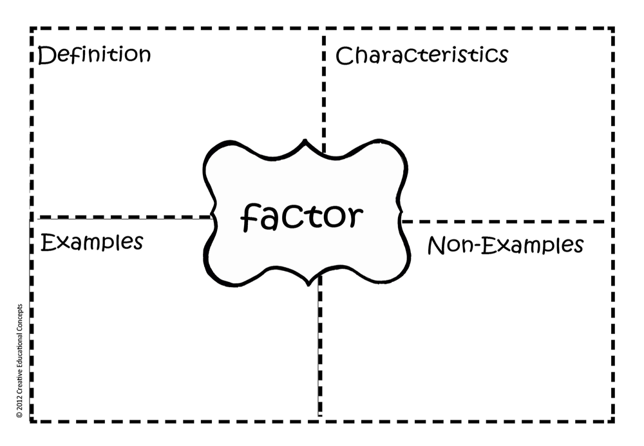

Slide 25
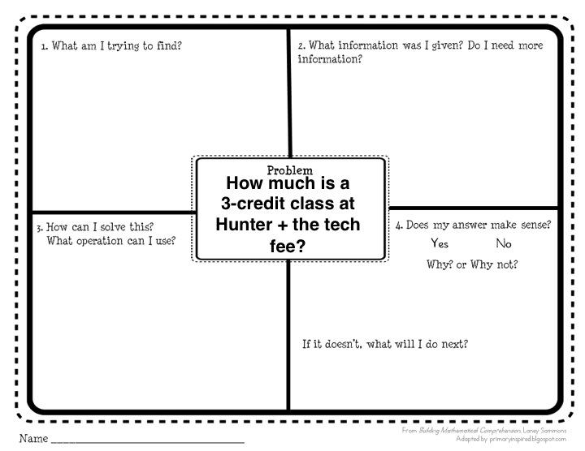

Slide 26
Four Corners

Slide 27
Which of the following is an example of a quadratic equation?
12 + 7 (6 - 4)
5
6(x + 3) = 24 (x +0)
c. ax² + 4x + b = 21
d. 5x = 6 + 3y
= 41

Slide 28
Which of the following sentences says “I took a shower” in IPA?
/aɪ,tukə’θawər/
b. /aɪ,tʊkə’ʃaʊər/
c. /ɛɪ,tʊkə’θawər/
d. /ɛɪ,tukə’ʃaʊər/

Slide 29
In response to various stressors, ________ increases your heart rate and respiration.
Oxytocin
Problem-focused coping
c. The general adaptation syndrome
d. The sympathetic nervous system

Slide 30
Resources + Links:
CTL website: http://bit.ly/CTLProgramming
Active learning strategies: http://bit.ly/baruchal
3. Math resource pack: http://bit.ly/MathActiveLearningResources
4. Laurie - laurie.hurson@baruch.cuny.edu Lindsey - lindsey.albracht@baruch.cuny.edu

