Slide 1
Thinking like a Researcher
Research Methods
Fall 2015
September 8th

Slide 2
Overview
Units of Analysis: what/who to research
Sampling: finding what/who
Variables: defining & measuring what/who
Stats: analyzing what/who

Slide 3
Units of Analysis
Units of Analysis: the person, collective or object being studied
AKA What or whom is being studied
Typical units of Analysis
Individual
Group
Organization/Firm
Social Interaction/Event
Social Artifacts
Neighborhood

Slide 4
Individuals
Must choose a population of individuals to study
Individuals should be similar in some way
Females, Prison inmates, Gays & Lesbians, Residents of a specific place/neighborhood, Police officers
If individuals are the unit of analysis:
Descriptive studies aim to describe characteristics of the population to which the individuals belong
Explanatory studies aim to discover the social dynamics operating within that population

Slide 5
Groups
Social groups can be units of analysis
Interested in characteristics that belong to one group
Example: investigate social differences between gangs
Study various gangs (groups) to understand differences
Other examples:
Families/households
Couples
Cities
Professions

Slide 6
Organizations
Organizations: groups of individuals brought together in a formal manner
Corporations
Social service agencies
Police precincts
Government offices/divisions
Research multiple groups or organizations in order to compare and contrast
Gather and compare data about each group or organization not the individuals within them

Slide 7
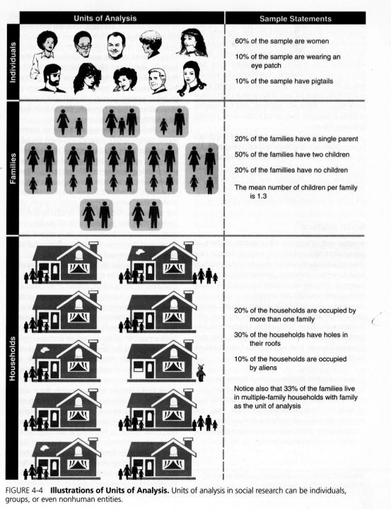

Slide 8
Social Interactions/Events
Study the interactions between individuals
Board room meetings, Homicides, traffic accidents, riots, weddings, twitter conversations
The unit of analysis is the action component
What was said in meeting, tweets, murders, etc.
Can also study a social artifact
Any product or creation of social beings or their behavior
Examples: books, laws, buildings, job types
How many laws contain language that…

Slide 9
Units of Analysis Activity
For each excerpt, name the unit of analysis and identify the type of unit
Women watch TV more than men because they are likely to work fewer hours outside the home than men.
Of the 130 incorporated US cities with more than 100,00 inhabitants in 1960, 126 had at least two short-term nonproprietary general hospitals.
The early Transcendental Meditation organizations were small and informal. The LA group, begun in June 1959, met a member’s house.
However, it appears that the nursing staffs exercise strong influence over…a decision to change the nursing care system.

Slide 10
Units of Analysis Activity
Though 667,000 out of 2 million farmers in the US are women, women historically have not been viewed as farmers but rather as the farmers wife.
The analysis of community opposition to group homes for the mentally handicapped…indicates that deteriorating neighborhoods are most likely to organize in opposition, but that upper-middle class neighborhoods are most likely to enjoy private access to local officials.
This paper examines variations in job title structures across work roles. Analyzing 3,173 job titles in the California civil service system in 1985…

Slide 11
Finding the Units of Analysis
Population: group of people/events researchers are interested in researching
Example : Transgender Inmates
Sample: smaller subject of people/groups/event used in order to conduct research
Sampling: assembling and reaching out to this smaller subset to conduct research
Transgender inmates in the NY prison system

Slide 12
Probability Sampling
Probability sampling: using random selection to create sample
Every person in your population must have equal chance to be chosen in the study
Probability sampling relies on probability theory
Branch of math that allows research to statistically analyze the results of their sampling
All large scale surveys use probability sampling
Ensures that your sample is representative of the whole population that you are studying

Slide 13
Nonprobability Sampling
Nonprobability sampling: a sampling technique used when sample is not selected randomly
Relies on samples that you choose or that are easy to reach
Used more often when you are looking for a specific population
More common in social science research
Inmates, police officers, criminal offenders, immigrants

Slide 14
Types of Nonprobability Sampling
Available subjects: Relying on available subjects
Data often not generalizable
Cheap and easy
Example: Participating in research studies in Psych 101
Gives researchers a starting point for larger studies

Slide 15
Types of Nonprobability Sampling
Purposive Sampling: Researcher selects sample based on their knowledge of that population and purpose of the study
AKA judgmental sampling: Units selected on the basis of the researcher’s knowledge
Find individuals who fit the criteria you are interested in
Examples: Student leaders, Right-wing individuals, Inmates in solitary confinement, Immigrants from Africa

Slide 16
Types of Nonprobability Sampling
Snowball sampling: Gather a sample by conducting interviews and following leads to new individuals or groups
Employed in field research
Each person you interview may give you leads to another person to interview and so on
Can illuminate connections between people, groups, and organizations

Slide 17
Types of Nonprobability Sampling
Selecting Informants: find someone well-versed in the social phenomenon that you wish to study
Different from respondent – just someone who answers survey or interview questions without prior knowledge
This sampling technique is good if you are trying to learn about a specific (and maybe hard-to-access) social phenomenon/interaction
Example: corruption, social networks in neighborhoods

Slide 18
Once you have found what/who to study
Units of Analysis
Sample
Must figure HOW to study them
Need to ask: what am I measuring?
AKA How do you define your variables?

Slide 19
Variables: Part 1
Variable: a quantity or quality that varies across people or situations
Quantitative variable: quantity that is measured by a number (i.e. height)
Categorical variable: Quality that is measured by assigning a category label (i.e. eye color)
How do you define your variables?
Need to ask: what am I measuring?

Slide 20
Variables: Part 2
Variable: a measurable representation of an abstract construct (an idea created to explain a phenomenon)
Example: Personality; Coping skills
Concept: characteristics/attributes associated with objects, events, or people
Extroversion; Seeking social support
Example:
Variable: Social Class
Concepts/Attributes: Upper, middle, lower classes

Slide 21
Defining Variables
How do you define your variables?
Need to ask: what am I measuring?
Operational definition: definition of the variables in terms of exactly how it will be measured.
Example: Aggression

Slide 22
Homework
Find a recent news article about the topic you want to focus on for your research proposal.
Print the news article. Write a short summary (100-200 words).
Define/Outline:
a possible research question.
the unit of analysis.
possible variables.

Slide 23
Units of Analysis & Variables
White males who receive plea bargains
Treatment of Transgender individuals in prisons
Economic inequality in New York City
Police Brutality rates, reporting, and gender
Legalization of Marijuana in CO
Human trafficking of females age 17-25 in Cambodia
Gentrification in Brooklyn neighborhoods
BLM movement awareness

Slide 24
Variables: Part 3
When looking for statistical relationships:
Independent Variables explain other variables
Cause, X
Dependent variables are explained by other variables
Effect, Y
Changes in the independent variable (X) causes changes in (effects) the dependent variable (Y)

