Slide 1
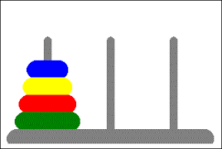
EDSE 2700E
Middle and Secondary School Mathematics: Teaching Developmentally
Dr. Shana Elizabeth Henry
2nd of April 2015

Slide 2
EDSE 2700E
Middle and Secondary School Mathematics: Teaching Developmentally
Dr. Shana Elizabeth Henry
2nd of April 2015
 | Activity | Minutes | Time
1 | Reflection of Last Class | 5 min | 7:30 – 7:35
2 | Articles, Discussion Questions | 25 min | 7:35 – 8:00
3 | Warm UP:: 24 Game | 10 min | 8:00 – 8:10
4 | Tower of Hanoi | 50 min | 8:10 – 9:00
5 | Gobblet | 10 min | 9:00 – 9:10
6 | Review Info for next week | 10 min | 9:10 – 9:20

Slide 3
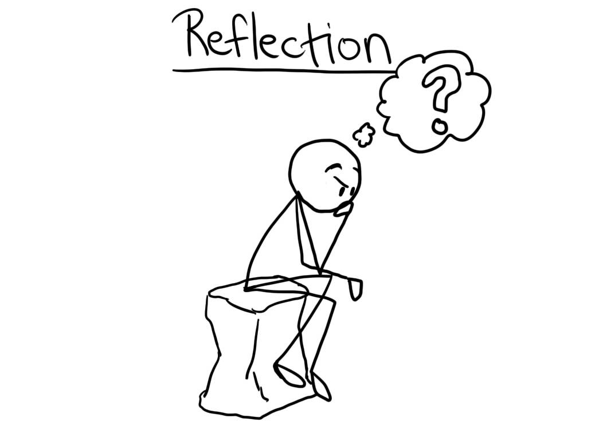
Weekly Topic: Geometric Thinking & Geometric Concepts Mar. 19th, 2015

Slide 4
Week 9: Mathematical Games
&
Puzzles

Slide 5
R&R
Quinn, Koca, & Weening. (1999). Developing mathematical reasoning using attribute games. . 481

Slide 6
Open discussion of the article.
What mathematical thinking do you want students to learn from playing games/puzzles?

Slide 7
Games/Puzzles involving
mathematical thinking

Slide 8
Games/Puzzles involving
mathematical thinking
Mathematical games needs to have two or more players, who take turns, each competing to achieve a winning situation of some kind, each able to exercise some choice about how to move at any time through the playing.
Four in a row, chess, reversi, checkers and chinese checkers are all mathematical games.

Slide 9
Games/Puzzles involving
mathematical thinking
Tower of Hanoi, Rubik cube and soltaire (board game
not card game) are puzzles that involve mathematical thinking.
Games that involve strategy are beneficial for supporting mathematical thinking. Games that totally rely on chance are not mathematical games.
Exploring whether it matters who goes first builds opportunity for systematic thought and pattern recognition giving students the opportunity to think creatively, identify, test, and refine winning strategies.

Slide 10
Week 9: Mathematical
Games & Puzzles

Slide 11
Warm Up 24 Game
Electronic Version

Slide 12
Tower of Hanoi!!
DO NOW: 1. Read the directions. Get into groups of 3/4 persons (there are 6 sets).

Slide 13
Lesson Breakdown | Activity | Time | Time
1 | Warm Up | 5 min | 10:35 – 10:40
2 | Complete Do Now: | 20 min | 10:40 – 11:00
3 | Tower of Hanoi | 15 min | 11:00 – 11:15
4 | Solving the Equation | 20 min | 11:15 – 11:35
5 | Discussion of movement. Now play online and time yourself. | 20 min | 11:35 – 11:55
6 | Leave no Trace | 10 min | 11:55 – 12:05

Slide 14
Objectives
How to explain the Tower of Hanoi.

Slide 15
Objectives
How to explain the Tower of Hanoi.
How to show the connection between the three views of a function: chart, formula and graph.

Slide 16
Class project

Slide 17
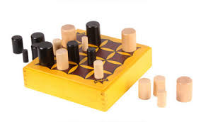
Gobblett

Slide 19
Hybrid Course
Timeframe: 30 minutes per task
Task: Create online a portfolio of mathematical tasks that use manipulatives to engage students in their mathematical development.
Deadline: Post the link to your online portfolio by the beginning of class, May 15th, 2015.
Gallery Walk: May 15th, 2015

Slide 20
Minimum Requirements
Image of manipulative
Mathematical task
Appropriate grade range
Topic(s) that the task develops
Solution
Cite your source(s)

Slide 21
Review Info for next week

Slide 22
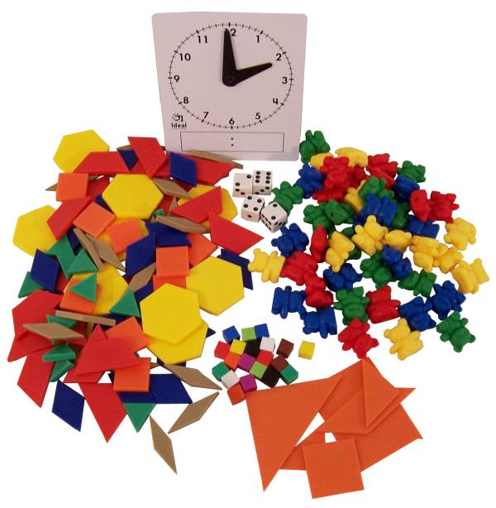
Review Info for next week

