Slide 1
EDSE 2700E
Middle and Secondary School Mathematics: Teaching Developmentally
Dr. Shana Elizabeth Henry
19th of March 2015

Slide 2
EDSE 2700E
Middle and Secondary School Mathematics: Teaching Developmentally
Dr. Shana Elizabeth Henry
19th of March 2015
 | Activity | Minutes | Time
1 | Reflection of Last Class | 5 min | 7:30 – 7:35
2 | Articles, Discussion Questions | 15 min | 7:35 – 7:50
3 | Planning for Final Project | 30 min | 7:50 – 8:20
4 | Activity w/ Summary | 55 min | 8:20 – 9:15
5 | Review Info for next week | 5 min | 9:15 – 9:20

Slide 3
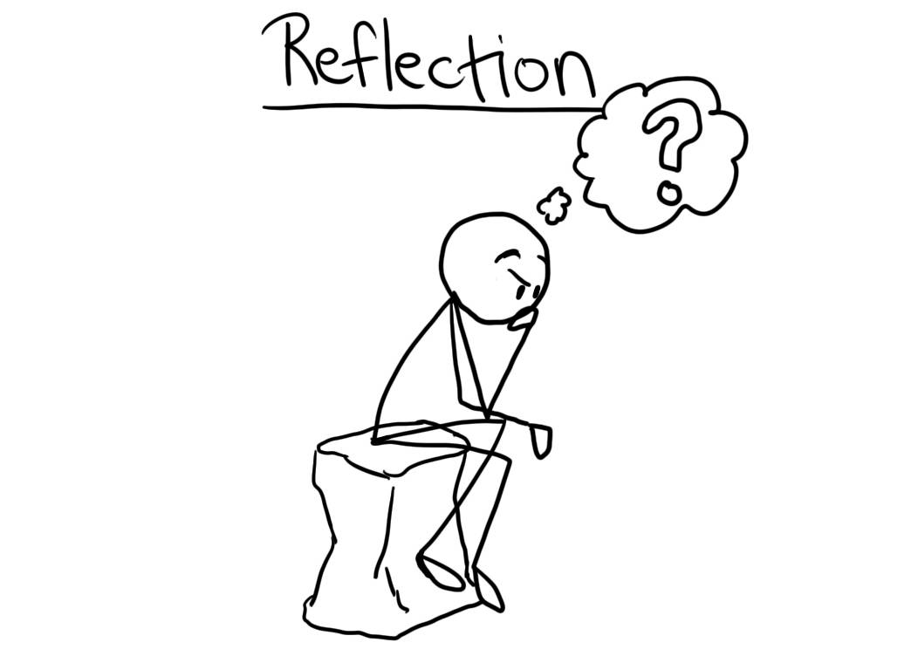
Weekly Topic: Developing Concepts of Exponents, Integers, and Real Numbers Mar. 12th, 2015

Slide 4
Week 7: Geometric Thinking
&
Geometric Concepts

Slide 5
R&R
Malloy. (1999). Perimeter and area through the van Hiele model.
Murrey. (2008). Differentiating instruction in mathematics for the
English language learner.p. 481

Slide 6
Van de Walle noted that students should
never use formulas without participating
in the development of those formulas (2001). p. 149
For all the investigations, students are expected to work collaboratively.
p.149

Slide 7
Planning for Final Project
Share five copies of a written description of your chosen concept and the task or activity you intend to use in order to receive feedback from the me and from your classmates.

Slide 8
Week 7: Geometric Thinking
&
Geometric Concepts

Slide 9
Warm Up Flag Symmetry

Slide 10
Arithmetic vs. Geometric
Notes:
Reciprocal of x = 1/x
Both the geometric and harmonic means must deal with positive real numbers. If a zero occurs, the geometric mean is zero, while the denominator for the harmonic mean would be infinity, meaning you’d get as close to zero there as is possible. With negative numbers any root of a negative puts you in imaginary number land, and regarding the harmonic mean, if they are all negative that would be ok but a mix of neg and pos would result in funky stuff.

Slide 11
What’s an average?
Notes:
Reciprocal of x = 1/x
Both the geometric and harmonic means must deal with positive real numbers. If a zero occurs, the geometric mean is zero, while the denominator for the harmonic mean would be infinity, meaning you’d get as close to zero there as is possible. With negative numbers any root of a negative puts you in imaginary number land, and regarding the harmonic mean, if they are all negative that would be ok but a mix of neg and pos would result in funky stuff.

Slide 12
What’s an average?
The mean we typically use is the arithmetic mean
Notes:
Reciprocal of x = 1/x
Both the geometric and harmonic means must deal with positive real numbers. If a zero occurs, the geometric mean is zero, while the denominator for the harmonic mean would be infinity, meaning you’d get as close to zero there as is possible. With negative numbers any root of a negative puts you in imaginary number land, and regarding the harmonic mean, if they are all negative that would be ok but a mix of neg and pos would result in funky stuff.

Slide 13
In fact there are many types of averages.
Notes:
Reciprocal of x = 1/x
Both the geometric and harmonic means must deal with positive real numbers. If a zero occurs, the geometric mean is zero, while the denominator for the harmonic mean would be infinity, meaning you’d get as close to zero there as is possible. With negative numbers any root of a negative puts you in imaginary number land, and regarding the harmonic mean, if they are all negative that would be ok but a mix of neg and pos would result in funky stuff.

Slide 14
What’s an average?
Arithmetic mean

Slide 15
What’s an average?
Arithmetic mean
Geometric mean

Slide 16
What’s an average?
Arithmetic mean
Geometric mean
Harmonic mean

Slide 17
What’s an average?
Arithmetic mean
Geometric mean
Harmonic mean

Slide 18
What’s an average?
Arithmetic mean
Pythagorean means
Geometric mean
Harmonic mean

Slide 19
Background Info
 | Sequence | Graph | Formula*
Arithmetic (by ________) | 1, 4, |  | a_{n} = a + (n – 1)d
Geometric (by _________) | 1, 4 |  | a_{n} = ar^{(n – 1)}

Slide 20
Background Info
 | Sequence | Graph | Formula*
Arithmetic (by ________) | 1, 4, 7, 10, 13… |  | a_{n} = a + (n – 1)d
Geometric (by _________) | 1, 4, 16, 64, 256… |  | a_{n} = ar^{(n – 1)}

Slide 21
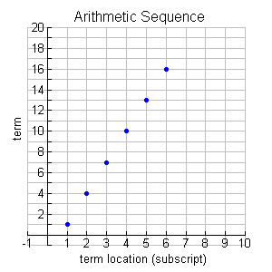
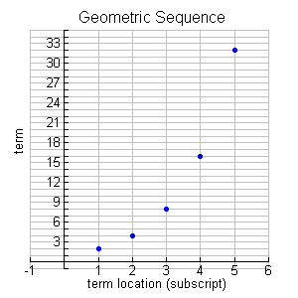
 | Sequence | Graph | Formula*
Arithmetic (by adding) | 1, 4, 7, 10, 13… | __________ | a_{n} = a + (n – 1)d
Geometric (by _________) | 1, 4, 16, 64, 256… | ____________ | a_{n} = ar^{(n – 1)}

Slide 22
 | Sequence | Graph | Formula*
Arithmetic (by adding) | 1, 4, 7, 10, 13… | __________ | a_{n} = a + (n – 1)d
Geometric (by multiplying) | 1, 4, 16, 64, 256… | ____________ | a_{n} = ar^{(n – 1)}

Slide 23
What’s an average?
 | Mean (of two numbers) | a.k.a | Example of 3 and 12
Arithmetic
Geometric

Slide 24
 | Mean (of two numbers) | a.k.a | Example of 3 and 12
Arithmetic | Add and divide by 2
Geometric

Slide 25
What’s an average?
 | Mean (of two numbers) | a.k.a | Example of 3 and 12
Arithmetic | Add and divide by 2 | Average
Geometric

Slide 26
What’s an average?
 | Mean (of two numbers) | a.k.a | Example of 3 and 12
Arithmetic | Add and divide by 2 | Average | (3 + 12) / 2 = 7.5
Geometric

Slide 27
 | Mean (of two numbers) | a.k.a | Example of 3 and 12
Arithmetic | Add and divide by 2 | Average | (3 + 12) / 2 = 7.5
Geometric | Multiply and take the nth root

Slide 28
 | Mean (of two numbers) | a.k.a | Example of 3 and 12
Arithmetic | Add and divide by 2 | Average | (3 + 12) / 2 = 7.5
Geometric | Multiply and take the nth root | Mean proportional

Slide 29
 | Mean (of two numbers) | a.k.a | Example of 3 and 12
Arithmetic | Add and divide by 2 | Average | (3 + 12) / 2 = 7.5
Geometric | Multiply and take the nth root | Mean proportional | where x =______

Slide 30
 | Mean (of two numbers) | a.k.a | Example of 3 and 12
Arithmetic | Add and divide by 2 | Average | (3 + 12) / 2 = 7.5
Geometric | Multiply and take the nth root | Mean proportional | where x = 6

Slide 31
 | Data Set | Formula | Calculate
Arithmetic | 1, 4, 16, 64, 256
Geometric | 1, 4, 16, 64, 256

Slide 32
 | Data Set | Formula | Calculate
Arithmetic | 1, 4, 16, 64, 256
Geometric | 1, 4, 16, 64, 256

Slide 33
 | Data Set | Formula | Calculate
Arithmetic | 1, 4, 16, 64, 256
Geometric | 1, 4, 16, 64, 256

Slide 34
What’s a geometric mean?
The geometric mean is particularly appropriate for exponential type of data
Notes:
Reciprocal of x = 1/x
Both the geometric and harmonic means must deal with positive real numbers. If a zero occurs, the geometric mean is zero, while the denominator for the harmonic mean would be infinity, meaning you’d get as close to zero there as is possible. With negative numbers any root of a negative puts you in imaginary number land, and regarding the harmonic mean, if they are all negative that would be ok but a mix of neg and pos would result in funky stuff.

Slide 35
What’s a geometric mean?
The geometric mean is particularly appropriate for exponential type of data
E.g. Human population over a period of time
Notes:
Reciprocal of x = 1/x
Both the geometric and harmonic means must deal with positive real numbers. If a zero occurs, the geometric mean is zero, while the denominator for the harmonic mean would be infinity, meaning you’d get as close to zero there as is possible. With negative numbers any root of a negative puts you in imaginary number land, and regarding the harmonic mean, if they are all negative that would be ok but a mix of neg and pos would result in funky stuff.

Slide 36
How do you find it?
Notes:
Reciprocal of x = 1/x
Both the geometric and harmonic means must deal with positive real numbers. If a zero occurs, the geometric mean is zero, while the denominator for the harmonic mean would be infinity, meaning you’d get as close to zero there as is possible. With negative numbers any root of a negative puts you in imaginary number land, and regarding the harmonic mean, if they are all negative that would be ok but a mix of neg and pos would result in funky stuff.

Slide 37
How do you find it?
Multiply the data set and take the n^{th} root of that number
Notes:
Reciprocal of x = 1/x
Both the geometric and harmonic means must deal with positive real numbers. If a zero occurs, the geometric mean is zero, while the denominator for the harmonic mean would be infinity, meaning you’d get as close to zero there as is possible. With negative numbers any root of a negative puts you in imaginary number land, and regarding the harmonic mean, if they are all negative that would be ok but a mix of neg and pos would result in funky stuff.

Slide 38
How do you find it?
Multiply the data set and take the n^{th} root of that number
Notes:
Reciprocal of x = 1/x
Both the geometric and harmonic means must deal with positive real numbers. If a zero occurs, the geometric mean is zero, while the denominator for the harmonic mean would be infinity, meaning you’d get as close to zero there as is possible. With negative numbers any root of a negative puts you in imaginary number land, and regarding the harmonic mean, if they are all negative that would be ok but a mix of neg and pos would result in funky stuff.

Slide 39
What’s a harmonic mean?
Notes:
Reciprocal of x = 1/x
Both the geometric and harmonic means must deal with positive real numbers. If a zero occurs, the geometric mean is zero, while the denominator for the harmonic mean would be infinity, meaning you’d get as close to zero there as is possible. With negative numbers any root of a negative puts you in imaginary number land, and regarding the harmonic mean, if they are all negative that would be ok but a mix of neg and pos would result in funky stuff.

Slide 40
What’s a harmonic mean?
The harmonic mean is good for things like rates and ratios where an arithmetic mean would actually be incorrect
Notes:
Reciprocal of x = 1/x
Both the geometric and harmonic means must deal with positive real numbers. If a zero occurs, the geometric mean is zero, while the denominator for the harmonic mean would be infinity, meaning you’d get as close to zero there as is possible. With negative numbers any root of a negative puts you in imaginary number land, and regarding the harmonic mean, if they are all negative that would be ok but a mix of neg and pos would result in funky stuff.

Slide 41
What’s a harmonic mean?
The harmonic mean is good for things like rates and ratios where an arithmetic mean would actually be incorrect
For example, average rate at which the donor fills a bag or average speed for driving your car
Notes:
Reciprocal of x = 1/x
Both the geometric and harmonic means must deal with positive real numbers. If a zero occurs, the geometric mean is zero, while the denominator for the harmonic mean would be infinity, meaning you’d get as close to zero there as is possible. With negative numbers any root of a negative puts you in imaginary number land, and regarding the harmonic mean, if they are all negative that would be ok but a mix of neg and pos would result in funky stuff.

Slide 42
How do you find it?
Notes:
Reciprocal of x = 1/x
Both the geometric and harmonic means must deal with positive real numbers. If a zero occurs, the geometric mean is zero, while the denominator for the harmonic mean would be infinity, meaning you’d get as close to zero there as is possible. With negative numbers any root of a negative puts you in imaginary number land, and regarding the harmonic mean, if they are all negative that would be ok but a mix of neg and pos would result in funky stuff.

Slide 43
How do you find it?
The reciprocal of the arithmetic mean of the reciprocals of all the values of the data set
Notes:
Reciprocal of x = 1/x
Both the geometric and harmonic means must deal with positive real numbers. If a zero occurs, the geometric mean is zero, while the denominator for the harmonic mean would be infinity, meaning you’d get as close to zero there as is possible. With negative numbers any root of a negative puts you in imaginary number land, and regarding the harmonic mean, if they are all negative that would be ok but a mix of neg and pos would result in funky stuff.

Slide 44
How do you find it?
Notes:
Reciprocal of x = 1/x
Both the geometric and harmonic means must deal with positive real numbers. If a zero occurs, the geometric mean is zero, while the denominator for the harmonic mean would be infinity, meaning you’d get as close to zero there as is possible. With negative numbers any root of a negative puts you in imaginary number land, and regarding the harmonic mean, if they are all negative that would be ok but a mix of neg and pos would result in funky stuff.

Slide 45
For example!
Suppose that you have four 10 km segments to your automobile trip. You drive your car:
100 km/hr for the first 10 km
110 km/hr for the second 10 km
90 km/hr for the third 10 km
120 km/hr for the fourth 10 km.
What is your average speed?
Notes:
Reciprocal of x = 1/x
Both the geometric and harmonic means must deal with positive real numbers. If a zero occurs, the geometric mean is zero, while the denominator for the harmonic mean would be infinity, meaning you’d get as close to zero there as is possible. With negative numbers any root of a negative puts you in imaginary number land, and regarding the harmonic mean, if they are all negative that would be ok but a mix of neg and pos would result in funky stuff.

Slide 46
another example!
Imagine a blood donor fills a 250mL blood bag at 70mL/min on the first visit, and 90mL/min the second visit. What is the average rate at which the donor fills a bag?
Notes:
250mL @ 70mL/min = 3.571 mins total
250mL @ 90mL/min = 2.778 mins total
So 500mL total in (3.571+2.778) mins total = 500/6.349 = 78.753 mL/min

Slide 47
What are the Pythagorean means?

Slide 48
What are the Pythagorean means?
The three "classic" means (the arithmetic mean), (the geometric mean), and (the harmonic mean)

Slide 49
How do I find it?

Slide 50
How do I find it?
The following relationship holds true for these averages
Harmonic ≤ Geometric ≤ Arithmetic

Slide 51
Example
Show the Pythagorean means relationship is true for the following data set:
5,20,40,80,100
Relationship: Harmonic ≤Geometric ≤ Arithmetic

Slide 52
MY Personal Time Line

Slide 53
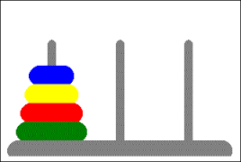
Class project

Slide 55
Hybrid Course
Timeframe: 30 minutes per task
Task: Create online a portfolio of mathematical tasks that use manipulatives to engage students in their mathematical development.
Deadline: Post the link to your online portfolio by the beginning of class, May 15th, 2015.
Gallery Walk: May 15th, 2015

Slide 56
Minimum Requirements
Image of manipulative
Mathematical task
Appropriate grade range
Topic(s) that the task develops
Solution
Cite your source(s)

Slide 57
Review Info for next week

Slide 58
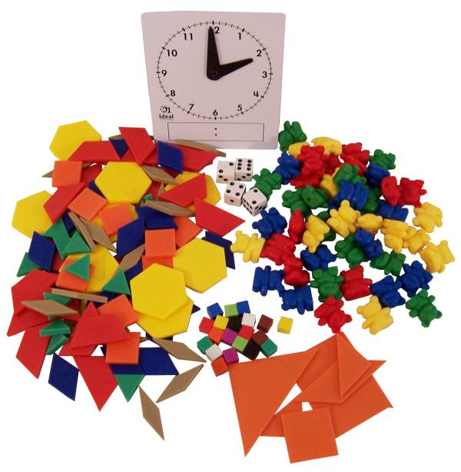
Review Info for next week

