Slide 1
EDSE 2700E
Middle and Secondary School Mathematics: Teaching Developmentally
Dr. Shana Elizabeth Henry
29th of January 2015

Slide 2
Julia
Tala
Alvin
Veronica
Christa
Deloreis
Anika
Alison
Gary
Zena
Katelyn
Guillermo
Maria
Barbara
Magna

Slide 3
EDSE 2700E
Middle and Secondary School Mathematics: Teaching Developmentally
Dr. Shana Elizabeth Henry
29th of January 2015
 | Activity | Minutes | Time
1 | Have you ever? | 15 min | 7:30 – 7:45
2 | Syllabus Review | 30 min | 7:45 – 8:15
3 | R &R Model | 40 min | 8:15 – 8:55
4 | BREAK | 15 min | 8:55 – 9:10
5 | Number Concepts & Number Sense Activity | 35 min | 9:10 – 9:45
6 | Review Info for next week | 15 min | 9:45– 10:00

Slide 4
Daily Topic: Number Concept and Number Sense Jan. 29th, 2015

Slide 5
Syllabus Review

Slide 6
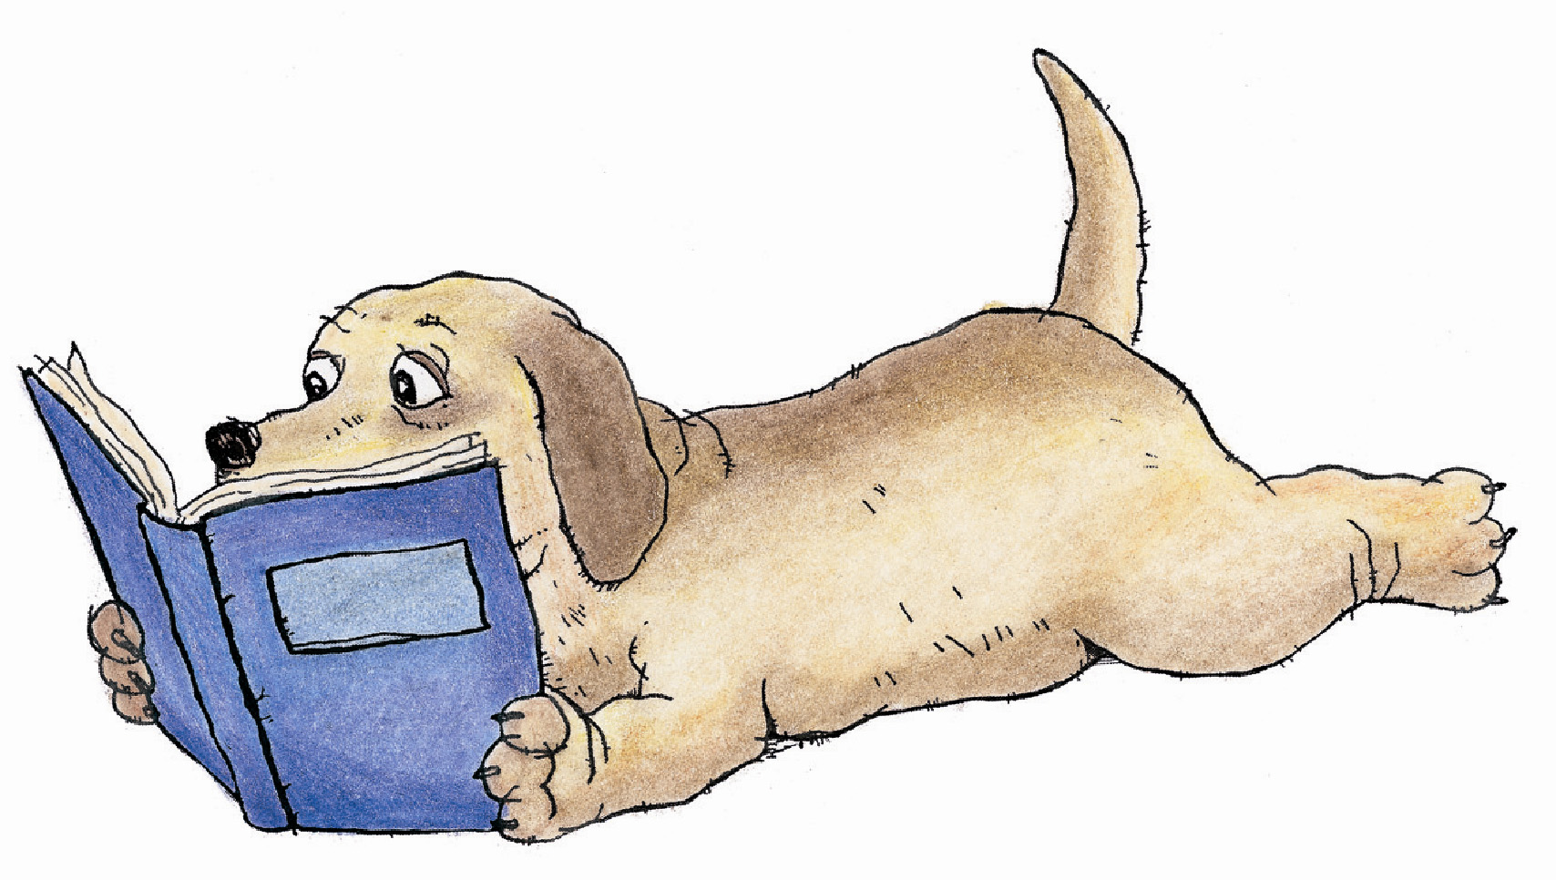
R&R#1:
Equitable Mathematics for All Students

Slide 7
Three Key Points
To provide equity in a mathematics education the curriculum, pedagogy, policies, and beliefs all need to change in order to achieve fairness, justice, and equality for all students.

Slide 8
Three Key Points
To provide equity in a mathematics education the curriculum, pedagogy, policies, and beliefs all need to change in order to achieve fairness, justice, and equality for all students.
Research shows that students cannot learn mathematics effectively by not being active participants during instruction. Teachers have to provide opportunities to learn where including multiple entry points of engagement minimizes disengagement.

Slide 9
Three Key Points
To provide equity in a mathematics education the curriculum, pedagogy, policies, and beliefs all need to change in order to achieve fairness, justice, and equality for all students.
Research shows that students cannot learn mathematics effectively by not being active participants during instruction. Teachers have to provide opportunities to learn where including multiple entry points of engagement minimizes disengagement.
Teachers can create opportunities to learn by having cooperative-learning, small-group experiences because group interaction promotes development of mental operations and improved attitudes towards their classmates. Research shows children tend to retain the talk they hear during small group interaction.

Slide 10
Connections
This article even though published in 1997 is still relevant today. Access, excellence, and equity are concerns in the mathematics education field. This article, “equitable mathematics for all students” discusses different groups that have historically been disengaged from the mathematics classroom due to social injustices both in school practices and due to educational policies (i.e. tracking). In future classes, we will connect this article to how small group tasks can increase opportunities to learn by engaging in rich tasks ourselves.

Slide 11
Connections
When I read, ‘opportunities to learn’ I connected that to during graduate school, reading about the ‘opportunity gap’. Students lack opportunities (disproportionately minorities, women, poor students) both inside and outside of school that they need in order to have equity among their peers. National/state standards today are demanding of teachers and schools that we account for the learning of ALL students. Lesson plans include descriptions of how to differentiate learning to meet all students’ needs.

Slide 12
If only
Another idea that struck me was ‘quantitative’ literacy which I was I had more time to investigate. Numerous ideas of literacy where mentioned: mathematical, innumeracy, and quantitative. These were mentioned in the context of social justice and having a society that is literate. If only I had time to understand a) how ones becomes mathematical literate b) what activities best increase mathematical literacy and c) what it means in our rapidly increasing technological world.

Slide 13
Reflection
By reading this article, I am reminded that it takes multiple constituents to bring equity into the classroom. I witness teachers engaging in thoughtful discussions about increasing student participation and learning. However, I hope for policymakers both educational and social to contribute to creating opportunities to learn and equity in professional development. Policies that can decrease poverty among children and youth would also help bring equity to the mathematics classroom.

Slide 14
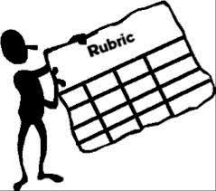

Slide 15
What mathematical literacy ‘skills’ are essential to acquire for employment, leadership positions, and social and economic advancement in an increasingly technological society?
What does equity look like in each of these three areas?
curriculum
instruction
assessment

Slide 17
Number Concepts & Number Sense
Number Concepts & Number Sense

Slide 18
Number Concepts & Number Sense
Purpose: To increase number sense and practice order of operations.
Number Concepts & Number Sense

Slide 19
Wavelengths of color
Dice
Baseball math

Slide 20
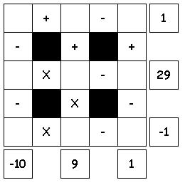
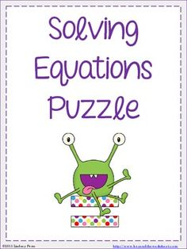

Slide 21
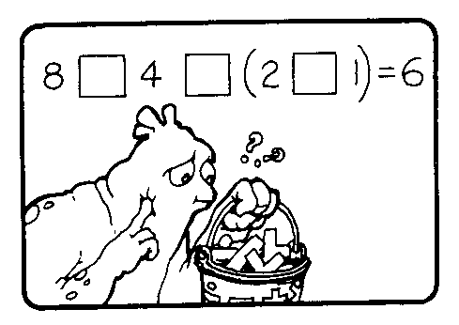
Warm Up
Using all four of the numbers 8, 4, 2, 1 in that order, make equations that equal 0 through 10. (You may use the operations +, – , × , ÷ in any order and any number of times.)
Example: 8 – 4 + ( 2 × 1 ) = 6
= 0
= 1
= 2
etc…

Slide 22
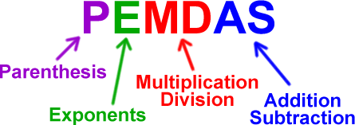
Class project
Using only and all of the digits 9, 8, 4, 1 (in any order) make equations using the following operations (+ - / * ^ or square root) that equals 1, 2, 3, …, 98, 99, 100. Remember to follow the order of operations.

Slide 23
Extension or Second Day of Numer Sense
“9 Clock” Rules: Build a mathematical clock with the hours represented by the number nine. In other words, build numerical equations, #1-12 using only the number nine (as many times as you want).
Do not repeat the number
nine more than three times.

Slide 24
Write a mathematical problem with an answer of 1, 2, 3, 4, etc. until 20 using exactly four fours, and no other numbers.
Use the numbers 1,2,3, and 4 only, to write math problems with the answers of 1,2,3,4,5,6,7,8,9,10,11, and 12. Encourage them to come up with more than one solution.

Slide 26
Hybrid Course
Timeframe: 30 minutes per task
Task: Create online a portfolio of mathematical tasks that use manipulatives to engage students in their mathematical development.
Deadline: Post the link to your online portfolio by the beginning of class, May 15th, 2015.
Gallery Walk: May 15th, 2015

Slide 27
Minimum Requirements
Image of manipulative
Mathematical task
Appropriate grade range
Topic(s) that the task develops
Solution
Cite your source(s)

Slide 28
Review Info for next week

