Slide 1
CASE STUDY OF MOBILES
Layout of the next/last two weeks
Day 01 -- Intro/weighing object Jan 12
Day 02 -- Theory & Model of mobiles Jan 13
Day 03 -- Algebra Jan 15
Day 04 -- Graphing Jan 16
Day 05 -- Construction Data Jan 20
Day 06 -- Construct & Reflection Jan 22

Slide 2
MOBILES
Jan 12th, 2015
CASE STUDY
OF
Presented by: Michael Nowak with support from Abby, Shana, Jade

Slide 3
Agenda Jan 12th, 2015
LT
What are mobiles?
Group project expectations
Move into groups
Weigh objects
LEAVE NO TRACE (including putting desks back)

Slide 4
LT: I can identify and define mobiles.
LT: I can articulate the expectations and outcomes of this case study.

Slide 5
What is a mobile?
A mobile is a type of kinetic sculpture constructed to take advantage of the principle of equilibrium.

Slide 6
What is a mobile?
A mobile is a type of kinetic sculpture constructed to take advantage of the principle of equilibrium.

Slide 7
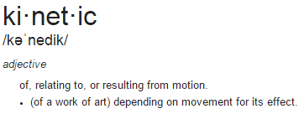
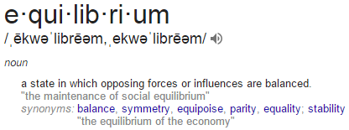
What is a mobile?
A mobile is a type of kinetic sculpture constructed to take advantage of the principle of equilibrium.

Slide 8
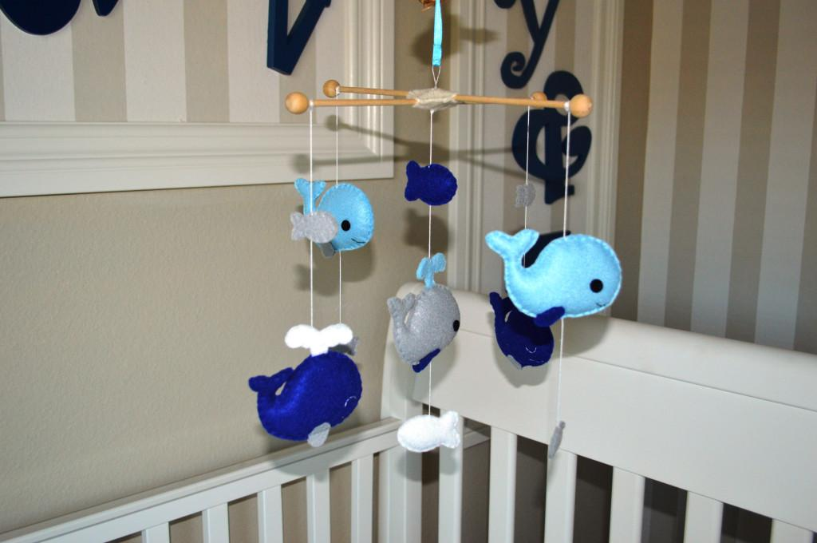
Remember these as a baby?

Slide 9
Remember these as a baby?
These are
mobiles!

Slide 10
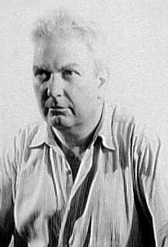
The History of Mobiles
Invented by Alexander
Calder in the late 1920s
(This cool dude)------->

Slide 11
The History of Mobiles
Invented by Alexander
Calder in the late 1920s
(This cool dude)------->
Mobiles belong to the 1916 European (specifically Switzerland) born art movement Dadaism
Term “mobile” was coined by the famous dadaist sculptor Marcel Duchamp in 1931 (It was meant to be a French pun)

Slide 12
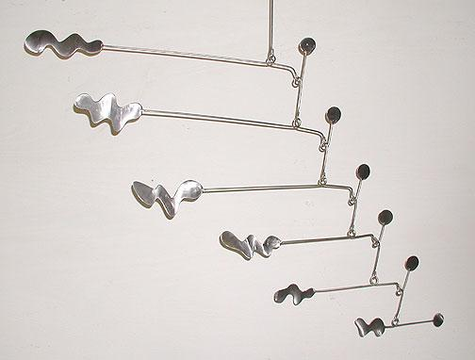
Here is an another example of a mobile:
Notice that it is totally balanced (principle of equilibrium)

Slide 13
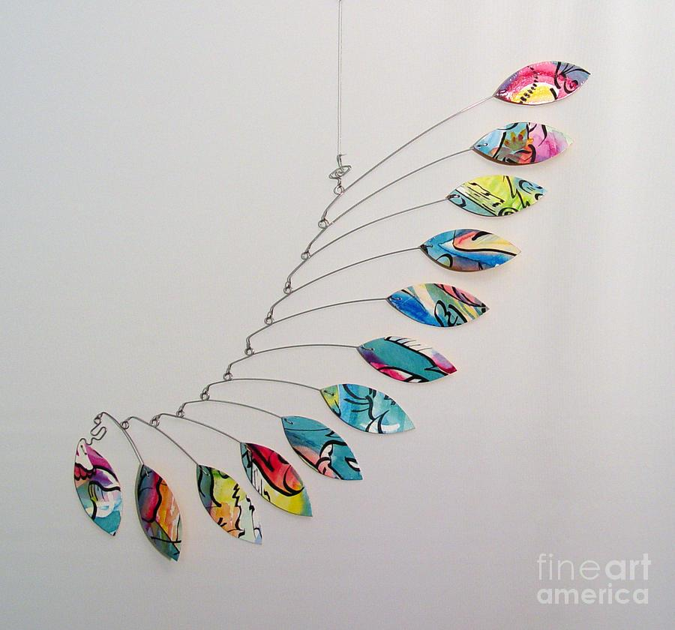
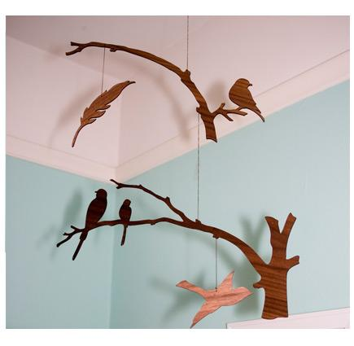
MORE MOBILES!!!!

Slide 14
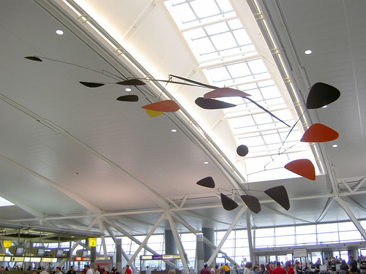
@ JFK airport
Alexander Calder mobile

Slide 15
As you can see
Mobiles consists of a number of rods, from which weighted objects or further rods hang. The objects hanging from the rods balance each other, so that the rods remain more or less horizontal. Each rod hangs from only one string, which gives it freedom to rotate.

Slide 16
Group Project Expectations
Process of making the groups
2.

Slide 17
Group Project Expectations
Process of making the groups
Core Value of Participation (Jumprope)

Slide 18
Group Project Expectations
Process of making the groups
Core Value of Participation (Jumprope)
Reflection at the end of your group’s ability to stay on task.

Slide 19
Group Project Expectations
Process of making the groups
Core Value of Participation (Jumprope)
Reflection at the end of your group’s ability to stay on task.
Be mindful of our space together.

Slide 20
Group Project Expectations
Process of making the groups
Core Value of Participation (Jumprope)
Reflection at the end of your group’s ability to stay on task.
Be mindful of our space together.
NO time to lose! Get into groups NOW.

